Slide 1

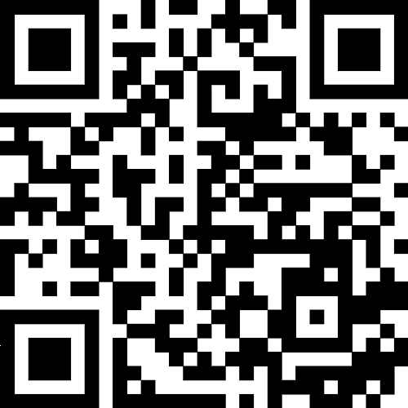
Bezpieczeństwo pacjenta zaczyna się ode mnie
Zeskanuj kod QR, aby przesłać zdjęcie swojej tablicy bezpieczeństwa pacjentów do 17 października.

Slide 2



















Spraw, by Twoja tablica bezpieczeństwa pacjenta była kolorowa i wyjątkowa!
Możesz wykorzystać poniższe elementy.

Slide 3
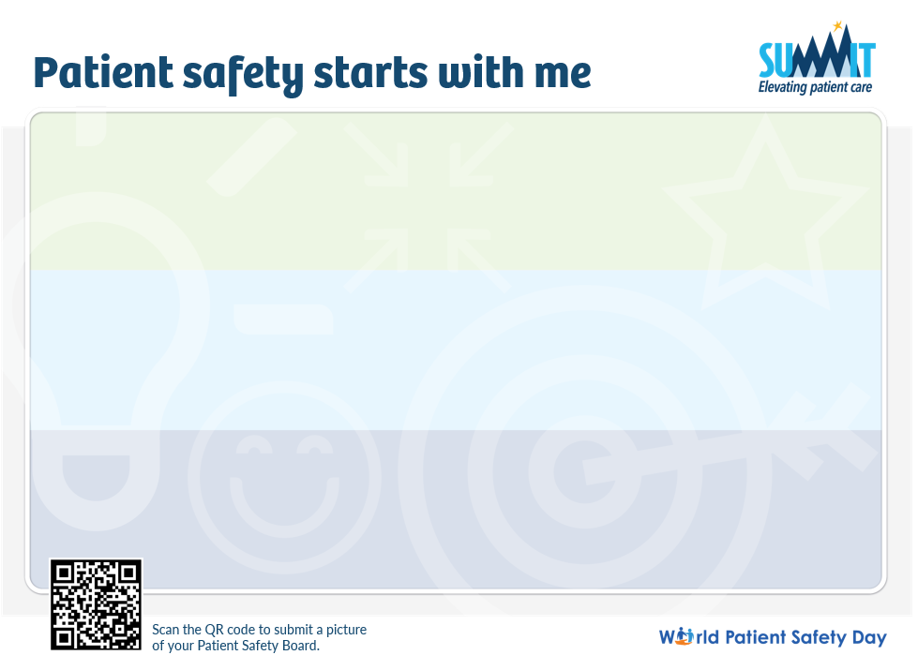

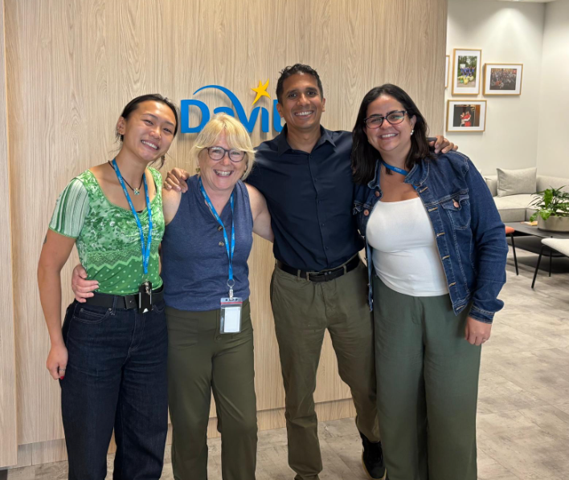
Potrzebujesz inspiracji? Zapoznaj się z poniższym przykładem.
Po ukończeniu tablicy prześlij jej zdjęcie, skanując kod QR.
I check access sites carefully every treatment. A patient once had slight redness turned out to be an early infection
I am always checking in when I see someone overwhelmed. A few weeks ago, someone looked flustered after back-to-back treatments. I helped clean the station so they could take a breath. We have to take care of each other to take care of our patients
To me, safety means giving every patient the confidence that we care as much about their well-being as they do. I remember when a new patient was anxious during their first dialysis session. I sat with them, explained the process, and answered all their questions. They told me later they felt safe because I took the time to care
I help by sharing the workload, especially on busy days, so no one feels rushed.
It means going home at the end of the day knowing we did the right thing for every patient.
Safety means our patients trust us to do the right thing, even when no one’s watching.
Making sure we always add FUN to our day to keep our day to keep everyone to our day to keep spirits high
During a busy day, someone almost hooked up a patient missing a check. I caught it and reminded them to check. No harm done, but it was a good reminder how easy it is to slip when we're rushing.
My role is to lead by example always follow protocols and never cut corners. Last month, I noticed a teammate almost skipped the final step in the machine check because we were short on time. I reminded them, and we did it together. It only took an extra minute, and we both felt better knowing it was done right.
I speak up when something doesn’t feel right, even if it’s small.

